Slide 1
Prototype part 2
Chain of thoughts prompt & Tool calling (Function calling)

Slide 2
Chain of thoughts prompt and Prompts chaining
Open 07_llm functional prototype.ipynb

Slide 3
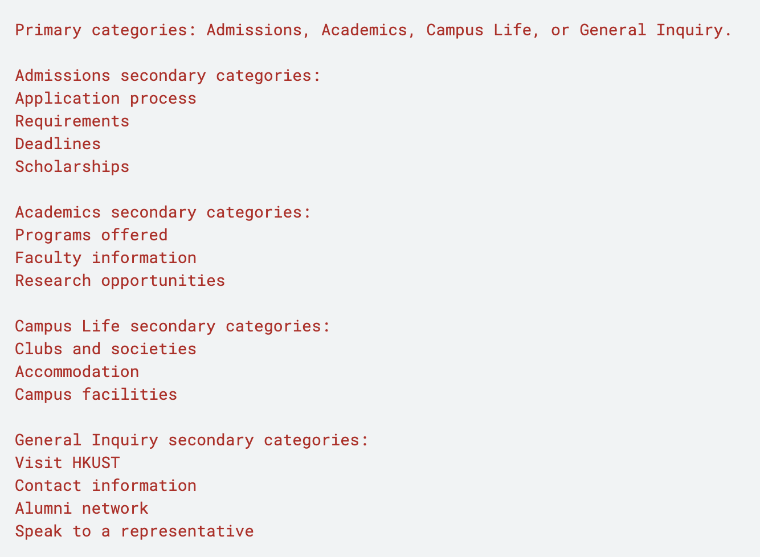
classification
Task: To classify inquiries about HKUST into specific categories based on the content provided.
Simple dataset example:
Primary category
Secondary category

Slide 4
classification
Step 1. Lower the model‘s temperature to achieve more deterministic and focused outputs.
Step 2. Set system prompt about the input, behavior, output and essential information.
Step 3. Format the response.

Slide 5
AI agents for a Souvenir Shop
Chain of Thought (COT) prompt:
CoT prompt is a technique used in AI to improve reasoning and problem-solving. It involves providing intermediate reasoning steps in a structured way, allowing the model to break down complex tasks into simpler parts.
Step 1: Break down complex tasks into simpler parts.
Step 2: Provide essential information for each task.
Step 3: Ensure the LLM follows the instructions step by step.
Optional: Use inner monologue to monitor the reasoning process.

Slide 6
prompt chaining
Prompt chaining: A technique where multiple prompts are used sequentially to guide the AI towards a final output.
Step 1: Break down complex tasks into simpler parts.
Step 2: Provide essential information for each task.
Step 3: Utilize multiple AI agents to complete a task by using the output from one agent as the input for another one. Optional: Use other tools to provide information (function calling)

Slide 7
Code sample
Task 1: Extract relevant product and category names.
Task 2: Retrieve detailed product information for extracted products and categories.
Function : Read Python string into Python list of dictionaries.
Task 3: Generate answer to user query based on detailed product information.
Task 4: Check if output is factually based on the provided product information.
>> Organize all agents for processing the user query

Slide 8
Function calling
Open 07_llm_funtion_call.ipynb

Slide 9
Function Calling
A mechanism to connect LLMs with external tools.
Crucial Concept: The model does NOT run your Python code by itself.
It only tells you which function to call and what arguments to use.

Slide 10
Function Calling
Define the Tool and Schema
We must translate our Python code into a JSON "manual" that the LLM can understand.
The Python function (get_current_weather(location, unit="celsius")).
The JSON Schema (tools = [{"type": "function", ...}]).
The Model Requests a Tool Call
The LLM pauses text generation and returns a structured request instead.
client.chat.completions.create(..., tools=tools)
The output: response.choices[0].message.tool_calls

Slide 11
Function Calling
Execute the Function Yourself
Python takes over. We map the LLM's string arguments to our real function.
Extracting the arguments using json.loads().
Running the local Python function: get_current_weather(**function_args).
Send the Result Back
We give the LLM the facts so it can write a human-friendly response.
Appending the tool response with role: "tool".
The second API call to generate the final answer.

Slide 12
Example 1
The Scenario: You are planning a trip and don't want to fiddle with dozens of filters on a booking website. You simply tell the AI: "I'm heading to Tokyo next Friday for a 4-night stay. Find me a boutique hotel near Shibuya, and keep the price under $250 a night.“
The LLM acts as your personal agent. It parses your natural language, calculates the dates (if given today's context), extracts your exact preferences, and formats them perfectly to query a hotel booking API (like Expedia or Booking.com).

Slide 13
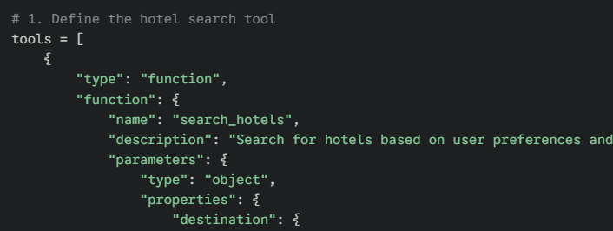
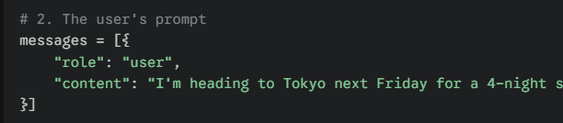
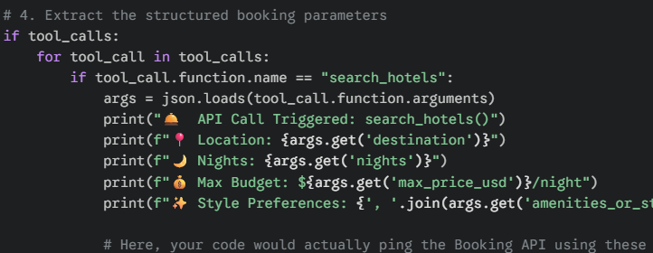
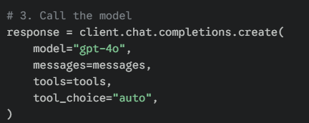
Example 1

Slide 14
Example 2
The Scenario: Imagine walking into your apartment after a grueling day. Instead of manually adjusting your Philips Hue lights, closing the smart blinds, and opening Spotify, you just say: "I had a terrible day and I'm super stressed. Draw a bath and set a relaxing mood in the bathroom."
The LLM doesn't just extract data here; it infers the appropriate settings based on human emotion. It translates "stressed" and "relaxing mood" into specific light colors (like dim blue or purple) and a specific music genre (like ambient or acoustic).

Slide 15
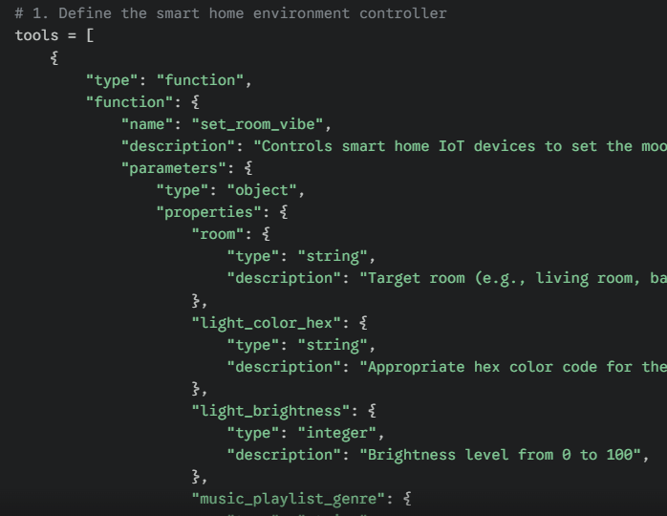
Example 2

Slide 16
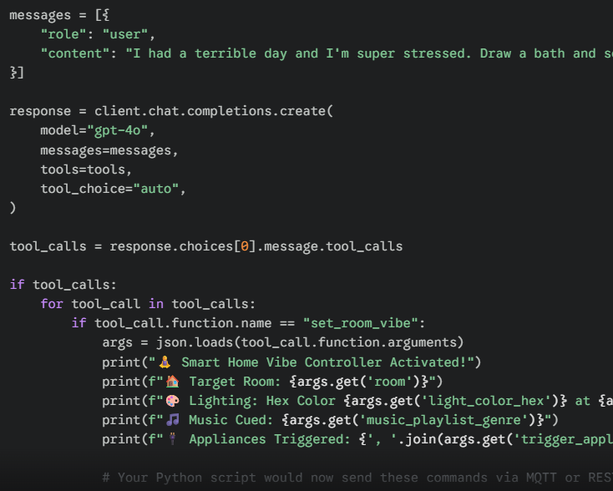
Example 2

